Slide 1

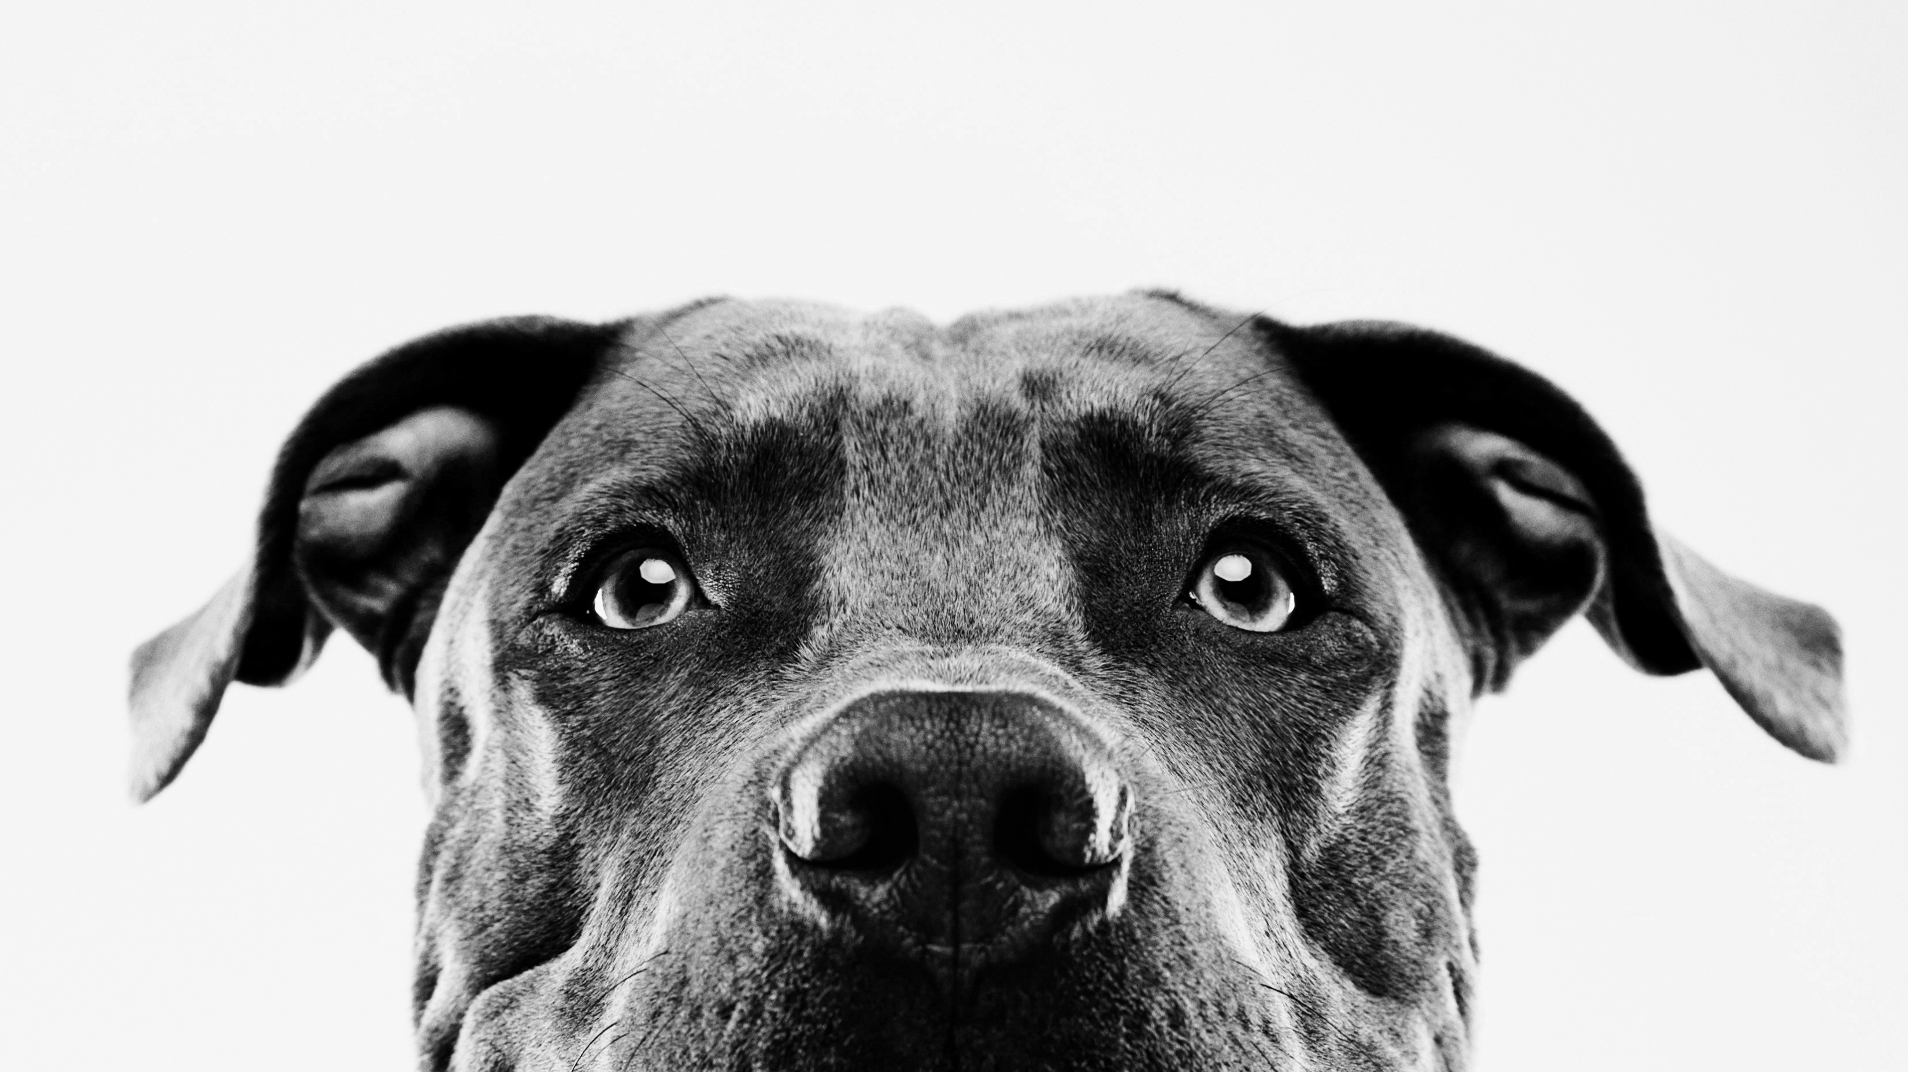

Pet adoption
z
Presented by:
Alexis Rojas
Johanna Belmar
Katharina Sojka
David Spir

Slide 2

Introduction
Our goal is to determine the various factors that influence pet adoption in order to predict which pets are more likely to be adopted. This dataset is imperative in finding solutions focused on increasing pet adoption rates. Therefore, using machine learning to find predictions can be an important tool in finding these solutions.
.

Slide 3
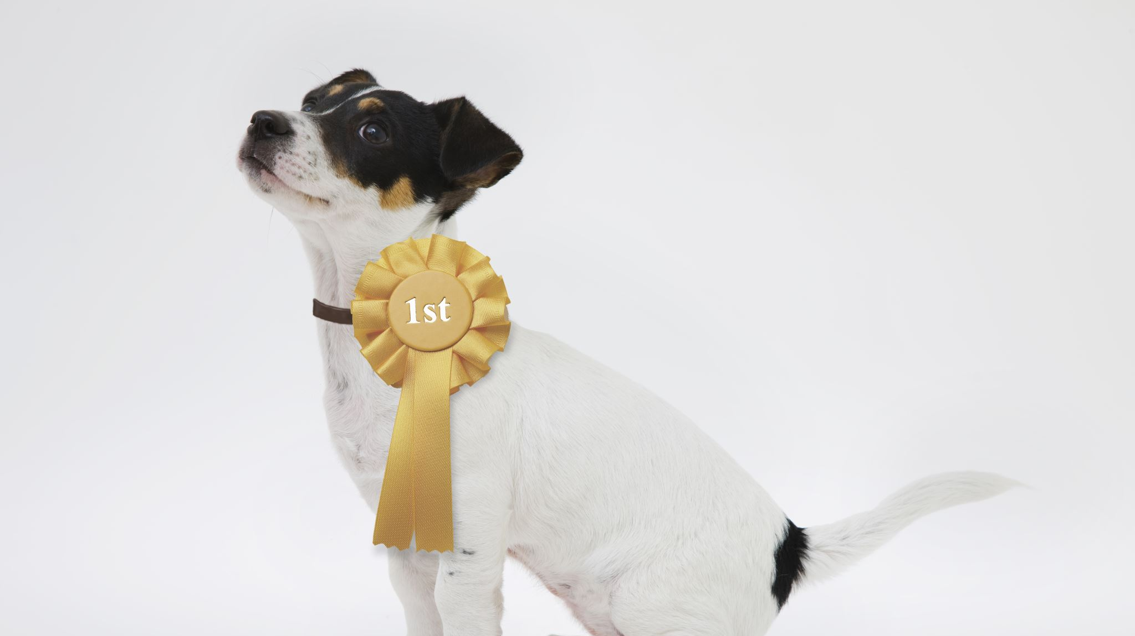
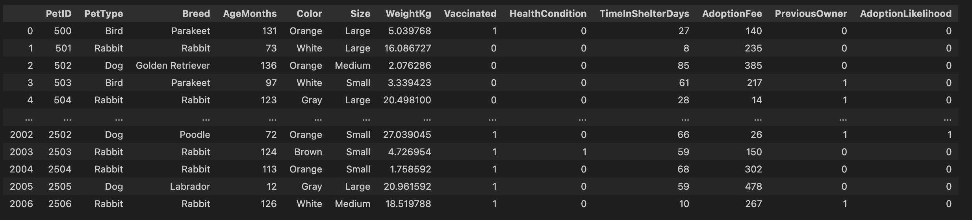
PET ADOPTION DATA
Organized data frame created in jupyter notebook:

Slide 4

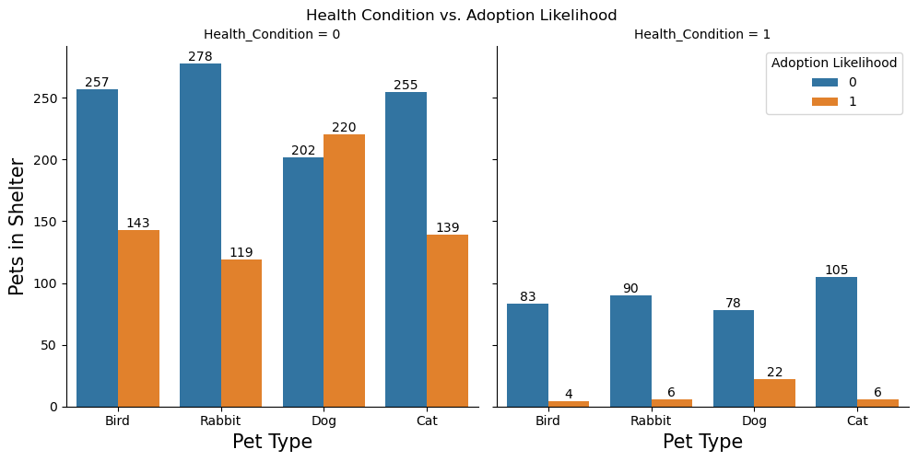
Health condition vs adoption likelihood
This graphic is a bar chart that compares the number of pets in shelters by pet type and adoption likelihood, grouped by health condition. The chart is divided into two main sections, each representing a different health condition
Notes:
This graphic is a bar chart that compares the number of pets in shelters by pet type and adoption likelihood, grouped by health condition. The chart is divided into two main sections, each representing a different health condition

Slide 5

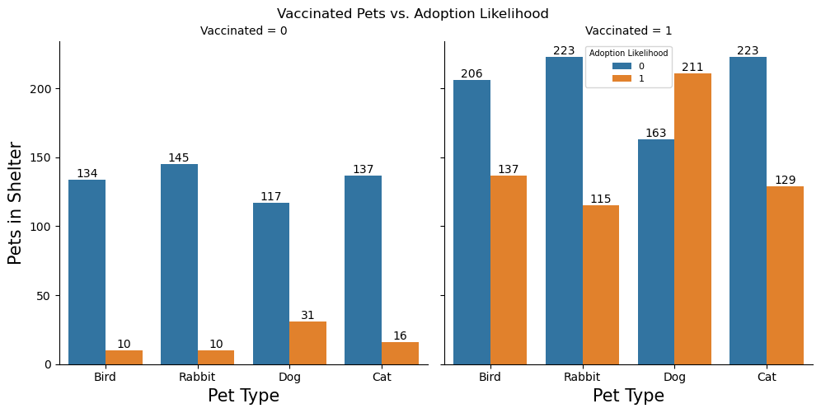
Vaccinated pets vs adoption likelihood
This visual representation highlights the impact of vaccination status on adoption likelihood for different types of pets in shelters. It suggests that vaccinated pets have a higher adoption rate compared to non-vaccinated pets, indicating that vaccination may play a crucial role in increasing the chances of pets being adopted.

Slide 6

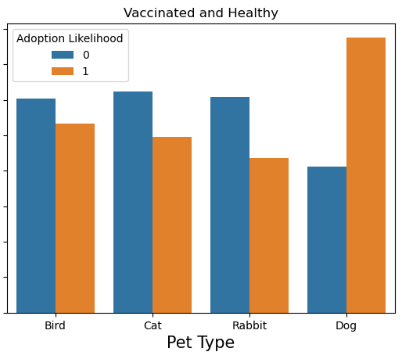
Vaccinated and healthy
This bar chart compares the number of vaccinated and healthy pets in shelters by pet type and their adoption likelihood. The chart presents data for four different pet types: Bird, Cat, Rabbit, and Dog, with two categories of adoption likelihood (0 for not adopted, 1 for adopted) indicated by different colors.

